Slide 1
STAT 9891 Classification
Project
By
Jorge Lopez and Oje Williams

Slide 2
Background
Companies have always maintained and developed various means by which their financial health can be ascertained. In doing this, predicting bankruptcy has become one of the main focuses over the years. Therefore calculating the probability of, and accurately predicting the likelihood of bankruptcy is a key component in many of the significant decisions companies make.
The dataset was obtained from kaggle and is based on Polish companies and it comprises some of their financial data collected from 2000-2013.

Slide 3
Dataset description
There are a total of 64 standardized features ranging from X1 to X64 each representing a financial measure such as net profit, total liabilities, working capital etc. While the response variable is stored as class( Solvent or Bankrupt).
Summary
n = 10000
p = 64
n₊ = 203
n₋ = 9797
Data source: https://www.kaggle.com/c/companies-bankruptcy-forecast/data?select=bankruptcy_Train.csv

Slide 4
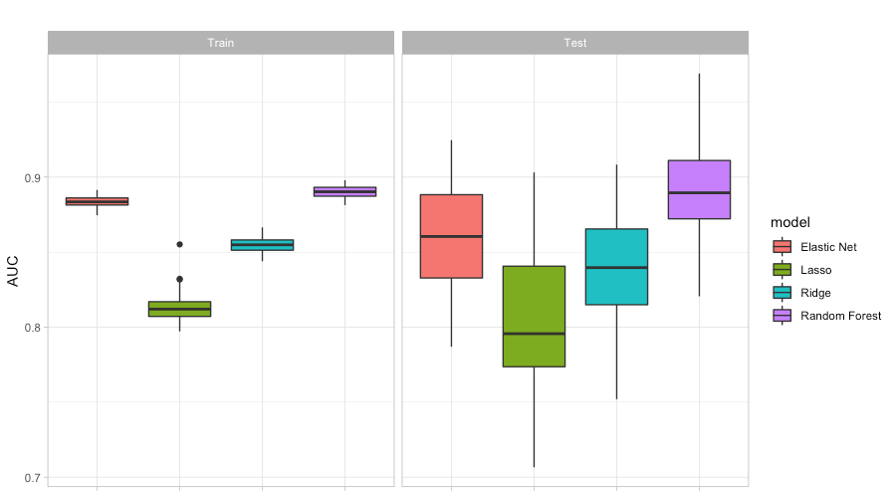
AUC Comparison

Slide 5
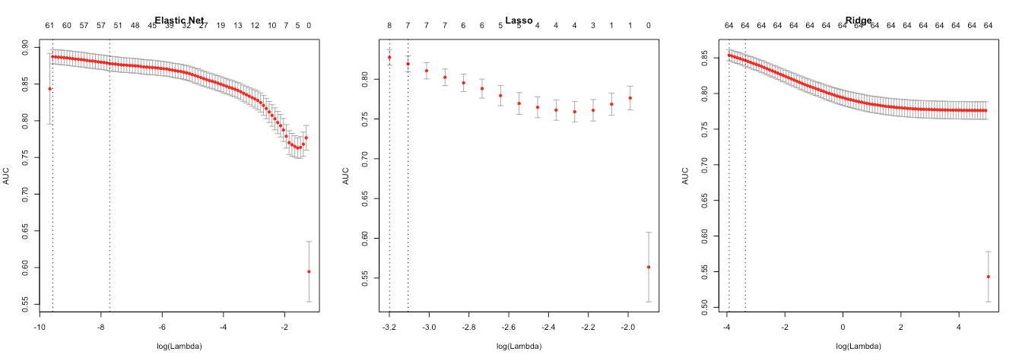
10 Fold CV Curves

Slide 6
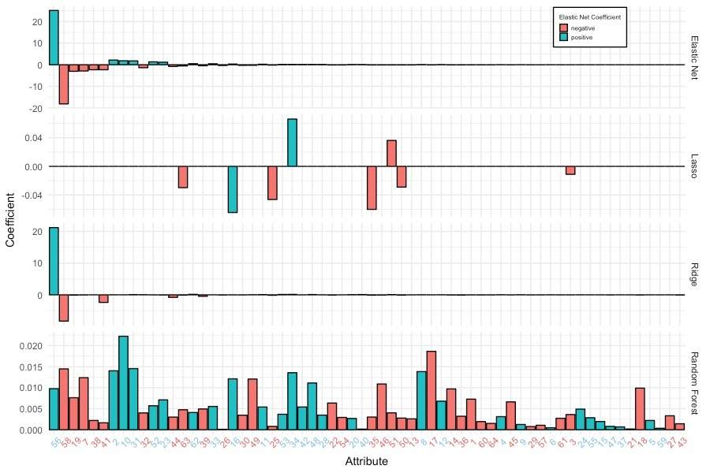
Coefficients
Most Significant
EN- X56
Lasso - X34
Ridge - X56
RF - X10
Notes:
X56 sales-cost of product sold/sales ...X34 operating expenses / total liabilities…..X10(equity / total assets)
EN - RF 2( total liabilities / total assets),10(equity / total assets),31((gross profit + interest) / sales), 52((short-term liabilities * 365) / cost of products sold)), 23(net profit / sales)

Slide 7
Features
X1 net profit / total assets
X2 total liabilities / total assets
X3 working capital / total assets
X4 current assets / short-term liabilities
X5 [(cash + short-term securities + receivables - short-term liabilities) / (operating expenses - depreciation)] * 365
X6 retained earnings / total assets
X7 EBIT / total assets
X8 book value of equity / total liabilities
X9 sales / total assets
X10 equity / total assets
X11 (gross profit + extraordinary items + financial expenses) / total assets
X12 gross profit / short-term liabilities
X13 (gross profit + depreciation) / sales
X14 (gross profit + interest) / total assets
X15 (total liabilities * 365) / (gross profit + depreciation)
X16 (gross profit + depreciation) / total liabilities
X17 total assets / total liabilities
X18 gross profit / total assets
X19 gross profit / sales
X20 (inventory * 365) / sales
X21 sales (n) / sales (n-1)
X22 profit on operating activities / total assets
X23 net profit / sales
X24 gross profit (in 3 years) / total assets
X25 (equity - share capital) / total assets
X26 (net profit + depreciation) / total liabilities
X27 profit on operating activities / financial expenses
X28 working capital / fixed assets
X29 logarithm of total assets
X30 (total liabilities - cash) / sales
X31 (gross profit + interest) / sales
X32 (current liabilities * 365) / cost of products sold
X33 operating expenses / short-term liabilities
X34 operating expenses / total liabilities
X35 profit on sales / total assets
X36 total sales / total assets
X37 (current assets - inventories) / long-term liabilities
X38 constant capital / total assets
X39 profit on sales / sales
X40 (current assets - inventory - receivables) / short-term liabilities
X41 total liabilities / ((profit on operating activities + depreciation) * (12/365))
X42 profit on operating activities / sales
X43 rotation receivables + inventory turnover in days
X44 (receivables * 365) / sales
X45 net profit / inventory
X46 (current assets - inventory) / short-term liabilities
X47 (inventory * 365) / cost of products sold
X48 EBITDA (profit on operating activities - depreciation) / total assets
X49 EBITDA (profit on operating activities - depreciation) / sales
X50 current assets / total liabilities
X51 short-term liabilities / total assets
X52 (short-term liabilities * 365) / cost of products sold)
X53 equity / fixed assets
X54 constant capital / fixed assets
X55 working capital
X56 (sales - cost of products sold) / sales
X57 (current assets - inventory - short-term liabilities) / (sales - gross profit - depreciation)
X58 total costs /total sales
X59 long-term liabilities / equity
X60 sales / inventory
X61 sales / receivables
X62 (short-term liabilities *365) / sales
X63 sales / short-term liabilities
X64 sales / fixed assets

Slide 8
Accuracy and time
Model | 90% AUC interval (test) . | CV time (minutes) | Fit time (minutes)
Elastic Net | (0.82 , 0.92) | 1.40 | 0.14
Ridge | (0.78 , 0.90) | 15.73 | 0.03
Lasso | (0.72 , 0.88) | 8.36 | 0.02
Random Forest | (0.84 , 0.95) |  | 4.76

Slide 9
Conclusion
Time
Elastic Net had the best overall time
Important Predictors
The overall best predictors were:
(sales - cost of products sold) / sales
equity/ total assets
Total liabilities/ total assets
&
( gross profit+interest)/sales
Performance
Random forest had the best performance all models had a large variation in test AUC
Notes:
2( total liabilities / total assets),10(equity / total assets),31((gross profit + interest) / sales)

Slide 10
THANKS!
ANY QUESTIONS?

